Slide 1
MedStar 2019 Health Plan Kick Off
2019 MedStar Select Overview
NOTE: This document is for training purposes only. Do not distribute.

Slide 2
MedStar Select PPO 2019 Employee Health Plan Overview
MedStar Select is an Employee PPO Plan
Built on the MedStar Select Provider Network, featuring MedStar Health and contracted physicians and hospitals, as well as key community clinical partners
We are a local health plan owned by MedStar Health. Our responsibility includes ensuring that as members of our communities, our associates and their families receive the highest level of quality care focused on health and wellness.
Currently, membership is >13,800, which includes associates and dependents.
Members have In-and-Out-of-Network benefits
Union plans exist for a small set of associates, specifically the NNU Nurse Union and SEIU Nurse Union
Notes:
Unions: Benefits are the same, but cost share is different.

Slide 3
MedStar Select PPO 2019 Employee Health Plan Overview
MedStar Select PPO Network:
MedStar Select PPO – Local Network
In-Network benefits through MedStar Select Provider Network including all MedStar Health facilities and associated providers, as well as closely aligned independent providers in the community.
Out-of-Area Network
PHCS/Multiplan – national network for Out of Service Area coverage
Out-of-Network Services
A member can see any Out-of-Network provider, but will have Out-of-Network cost shares associated with these visits
For discounts on Out-of-Network services, members can utilize the Multiplan network
Multiplan – Out-of-Network providers located within the MedStar service area

Slide 4
MedStar Select PPO 2019 Sample Identification Card
MedStar Select and SEUI Plan
No PCP requirement
PCP office visit co-pay: $0
Specialist co-pay: $30
ER: $250
Urgent Care: $10
MedStar Select NNU Plan
No PCP requirement
PCP office visit co-pay: $0
Specialist co-pay: $20
ER: $100
Urgent Care: $10

Slide 5
MedStar Select PPO Service Area
MedStar Select Local Service Area Includes:
DC
Maryland:
Anne Arundel County, Baltimore County, Baltimore City, Calvert County, Carroll County, Charles County, Frederick County, Harford County, Howard County, Montgomery County, Prince Georges County, St. Mary’s County
Virginia:
City of Alexandria, Arlington County, City of Fairfax, Fairfax County, City of Falls Church
When accessing medical care within the MedStar Select Service area, MedStar Select providers must be utilized in order to receive benefits at IN-NETWORK benefit level. For questions about participating providers, please call member services.
MedStar Select provider directory can be accessed at www.MedStarProviderNetwork.org

Slide 6
MedStar Select Out-of-Network Benefit
MedStar Select Plan is a PPO, allowing members the choice to see any provider at the Out-of-Network benefit level
MedStar Select members have benefits out of the MedStar Select Network at a higher cost share.
Anytime care is accessed by a member using a provider outside of the Select Network, regardless of if they are in or out of the service area, the member will be responsible for 40% coinsurance after their deductible, unless otherwise noted.
For Discounted Out-of-Network Services
Multiplan – Out-Of-Network within the MedStar Select Service area
The National Service area is the area inside of the MedStar Select Network
To obtain information regarding providers in the MultiPlan network, call member services at 855.242.4872
Emergency room visits are always covered at the in-network benefit level.

Slide 7
MedStar Select Out-of-Network Exceptions
There are specific circumstances under which out-of-network services are covered at the in-network benefit level:
Students, associates, and/or their dependents who reside outside of the service area can obtain in-network level benefit coverage for non-emergency Out-of-Network (OON) services when utilizing the PHCS network.
Traveling: While traveling out of the service area, your emergency room services will be covered at the in-network benefits level. Non-emergent care is covered at the OON benefit level while traveling.
Emergency care while traveling internationally is covered at the same benefit level as if the member were in the US. Depending on where services are received, the member may have to pay up front for medical expenses at the time of care. When the member returns home, they will be able to submit for reimbursement.
Lack of Access to Care: In the event that the MedStar network does not have adequate access to a specific provider type inside of the service area, a member or provider can request an authorization for an OON provider to be covered at the In-Network benefit level. Pre-Authorization is required.

Slide 8
In-Network Referrals
All providers are expected to utilize participating providers when making referrals. Please refer to the online directory at MedStarProviderNetwork.org for a list of participating providers, or contact provider services at 855-222-1042 for assistance.
Please refer laboratory services to the following in-network laboratories:
Laboratories at MedStar Health facilities
Quest (includes genetic testing services)
LabCorp (includes genetic testing services)
Please refer dialysis services to participating Dialysis centers:
DaVita

Slide 9
Prior Authorizations
The provider or patient is responsible for contacting the plan to obtain authorization before receiving select services.
If a prior authorization is required and one is not obtained, no payment will be made by the plan.
Please refer to the Quick Reference Guide at http://www.medstarprovidernetwork.org/2019-select-quick-reference-guide for a listing of common services requiring a prior authorization, or contact provider services at 855-222-1042 for assistance.

Slide 10
Drug Prior Authorizations
For drugs covered under the medical benefit, please refer to the following process:
To request Prior Authorization for medications covered under the Medical Benefit, please visit the following website: http://www.medstarprovidernetwork.org/medstar-select/pharmacy-resources/pharmacy-prior-authorization-forms
For a comprehensive list of drugs covered under the medical benefit, please reference the Provider Manual.
Contact the MedStar Pharmacy UM Services Team at
855-266-0712 for additional assistance.
To request Prior Authorization for medications covered under the Pharmacy Benefit, please contact CVS Caremark at 888.771.7282

Slide 11
Select Medical Benefits 2019
Benefit | In-Network | Out-of-Network
Calendar Year Deductible Copays do not count toward deductible, however deductible counts towards out-of-pocket maximum | $0 Individual $0 Family | $2,000 Individual $4,000 Family
Out-of-Pocket Maximum OOP includes deductible, copays and coinsurance amounts. It does not include pharmacy copays OOP Maximums for In- and Out-of-Network accumulate together. Copays for Out-of-Network Emergency Care accumulate toward the OOP Max. | $1,500 Individual $3,000 Family $1000 Individual and $2000 Family for NUU Plan | $6,000 Individual $12,000 Family
Coinsurance (Paid by Plan Participant, after deductible) | None, unless noted | 40%
Office Visit PCP | Paid In Full | 40% coins after ded
Office Visit Specialist | $30 copay $20 NUU Plan | 40% coins after ded
Preventive Care Services (per ACA) | Paid in full | 40% coins after ded
Diagnostic Services
Advanced Imaging (e.g. PET, MRI, CT) | $30 copay | 40% coins after ded
Other Imaging (e.g. X-ray, Sonogram) | $15 copay | 40% coins after ded
Lab and other services | Paid in full | 40% coins after ded
Emergency Care (copay waived only if admitted, Emergency services available out-of-network) | $250 copay $100 NUU Plan | $250 copay $100 NUU Plan

Slide 12
Select Medical Benefits 2019-Continued
Benefit | In-Network | Out-of-Network
Urgent Care | $10 copay | 40% coins after ded
Hospital Facility/Surgical Procedures
Outpatient Surgery | $50 copay per surgery | 40% coins after ded
Inpatient Hospitalization (pre auth required) | $100 copay per admission | 40% coins after ded
Medical Rehab coverage (medically necessary care – non custodial; limited to 30 days per illness or injury) | Paid in Full | 40% coins after ded
Morbid Obesity (pre auth required; ONLY performed at MedStar Centers of Excellence: currently bariatric surgery at Franklin Square and WHC) | Paid in Full | Not covered
Hospital Physician Services (Inpatient and Outpatient) | Paid in Full | 40% coins after ded
Allergy Services (including diagnostic testing and treatments such as injections and serums) | PCP: Paid in Full Specialist: $30 copay ($20 for NUU Plan) | 40% coins after ded
Immunizations and Inoculations (for common communicable diseases, tests and serums) | Paid In Full | 40% coins after ded
Reproductive Health
Maternity Care ($100 reimbursed into HRA account if you deliver at MedStar facility) Note that an authorization is required beyond 48 hours for vaginal delivery and 96 hours for cesarean section for both mother and baby. | $100 copay | 40% coins after ded
Infertility Services (pre auth required; benefits for AI and IVF are combined and limited to four attempts per year and six per lifetime. Includes injectable drugs only. Attempt defined by transfer of embryo. Available to same sex couples. Sterilization not covered.) | 50% coins | 50% coins after ded

Slide 13
Select Medical Benefits 2019-Continued
Benefit | In-Network | Out-of-Network
Therapy Services
Physical and Occupational (60 visits per year/combined); Speech Therapy (60 visits per year); Therapeutic manipulation (chiro: 30 visits per year; treatment plan required after 10 visits) and Acupuncture | $30 copay $20 NUU Plan | 40% coins after ded
Cardiac and pulmonary rehab | Paid in Full | 40% coins after ded
Medical Therapy Services (chemo, radiation, dialysis, infusion therapy) | Paid in Full | 40% coins after ded
Mental Health/Substance Abuse
Mental Health/Substance Abuse Inpatient hospital/facility and professional services | $100 copay per admission | 40% coins after ded
Office visits for mental health/substance abuse | Paid in Full | 40% coins after ded
Home Health Care Services
Home health care (60 visits per year, must be coordinated through care management) | Paid in Full | 40% coins after ded
Private duty nursing (pre auth required) | 10% coins | 40% coins after ded
Skilled nursing facility/SNF (pre auth required) | $100 copay per admission | 40% coins after ded

Slide 14
Select Medical Benefits 2019-Continued
Benefit | In-Network | Out-of-Network
Other Medical Services
Hospice Care, Organ Transplants (pre auth required) | Paid in Full | 40% coins after ded
Dental services related to accidental injury | 10% coins | 40% coins after ded
Diabetic equipment/education (supplies such as test strips, glucometers and insulin are covered under Rx plan); DME; orthotics, braces, and prosthetics (pre auth may be required and limitations may apply) | Paid in Full | 40% coins after ded
Nutritional Counseling (12 visit per year max; subject to medical necessity) | Paid in Full | 40% coins after ded
**Note this grid is for training purposes only, do NOT distribute to members.
If members wish to receive a copy of this, advise them to contact their corporate benefits department.

Slide 15
MedStar Select Pharmacy Benefit Manager – CVS Caremark
CVS Caremark is MedStar Select’s Pharmacy Benefit Manager
If a member does not have a MedStar Select pharmacy located at their work location, they are encouraged to call 443.777.6201 to learn how they can take advantage of the discount
Any questions regarding coverage must be directed to CVS Caremark at 888.771.7282 or visit www.Caremark.com
Please contact MedStar Select’s Pharmacy UM Team for assistance with drugs covered under the medical benefit.
855.266.0712
For a comprehensive list of drugs covered under the medical benefit, including prior authorization requirements, please refer to the Provider Manual.

Slide 16
MedStar Select Behavioral Health Vendor - Magellan
Magellan is the behavioral health vendor for MedStar Select.
To access the MedStar Select provider network, go to the portal (www.MedStarMyHealth.org) and click on “Find a behavioral health vendor” on the provider directory page
Click on “Behavioral Health Network for MedStar Select Plan”
This will open a new page onto the Magellan site
Click “Register or Enter as a Guest”
It will ask you enter a phone number:
MedStar Select number is 800.327.7855
Click “continue”
Scroll to bottom of page and click “Enter as a Guest”

Slide 17
Wellness

Slide 18
MedStar Employee Plan Wellness Programs
MedStar MyHealth services include:
MyHealth OnLine - www.MedStarMyHealth.org is a secure website with comprehensive wellness resources, health trackers, quizzes, programs etc.
MyHealth Questionnaire (MHQ) – online Health Assessment that provides a snapshot of overall wellness, complete with personalized results and interactive tools
If associates enrolled in MedStar Select complete the MHQ between the dates of 10/30/2018 - 11/29/2018, they will receive a $30 credit per month on their health insurance premiums for all of 2019
New hires are encouraged to participate within 60 days of eligibility to receive the credit for the remainder of the calendar year
Wellness Programs and Campaigns - available throughout the year with incentives/prizes for participation TBD by entity

Slide 19
MedStar Employee Plan Wellness – Tobacco Surcharge
Tobacco Surcharge:
MedStar Select will require all members to attest to usage/non-usage every year during the annual enrollment process
During annual enrollment process (online), members will attest to tobacco usage or non-usage
Tobacco users will be assessed a $50 per month surcharge stating on January 1, 2019
This surcharge is only applicable to MedStar associates enrolled in medical coverage
Members have an option to enroll and complete a MedStar-approved tobacco cessation program during the year to stop the surcharge. One of those options is the tobacco cessation program on the portal in the OnLine LifeStyle Programs under Self-Service Quick Links.
Materials distributed to associates during annual enrollment relating to the tobacco surcharge are provided for your reference
For all questions regarding the tobacco surcharge,
please refer all associates to their
Corporate Benefits Office at 410.933.2929

Slide 20
MedStar Employee Plan MyHealth Maternity Program
Available to MedStar Select members and dependents
Program Requirements:
$50 into HRA for completing initial assessment
Must be completed and member must enroll during 1st trimester to qualify for this reward
$50 into HRA for completing the program, including the postpartum assessment with your MyHealth Maternity Care Advisor
Member must have completed the initial assessment and enrolled during 1st trimester to qualify for this reward
$100 into HRA for a member who delivers at a MedStar facility
Does not require 1st trimester enrollment and is independent of assessments mentioned above
For more information, members can call 888.959.4033 between 8:30am and 5:00pm Monday-Friday

Slide 21
MedStar Employee Plan MyHealth Care Advising
Available to MedStar Select members and dependents
Program Requirements:
This is a targeted outreach program, members are not eligible for financial incentives unless they are contacted for enrollment
Members can enroll to work with Care Advisor voluntarily, however no financial reward will be given unless they are contacted via the targeted outreach
$25 into HRA for initial contact with Care Advisor
$100 into HRA for enrollment in program
$100 into HRA for completion of program or 6 month engagement
Members are eligible for financial incentive one time only
For more information, members can call 888.959.4033 between 8:30am and 5:00pm Monday-Friday

Slide 22
MedStar Employee Plan HRA Accounts for Incentives
Health Reimbursement Account (HRA):
Members enrolled in MedStar Select who participate in the MedStar MyHealth Maternity or Care Advising programs will receive incentives funded into an HRA.
HRA dollars can be used to offset out-of-pocket medical expenses such as copays and deductibles
No action needed by the member, by participating the member will be automatically enrolled
Once the account is established, the member will receive a welcome packet that includes their Healthcare Spending MasterCard or “Benny” card
HRA is administered by Trion, the same company that manages MedStar’s FSA account as well
If a member already has an FSA account, they can access both accounts from the same card
For a complete listing of eligible medical expenses, go to www.irs.gov/pub/irs-pdf/p502.pdf
For more information, members can call Trion at 800.580.6854 or via the web at www.EnrollOnline.com/MedStar

Slide 23
MedStar Employee Plan MedStar eVisit
MedStar offers an online acute care visit program for MedStar Select members
All visits are online and are accessible 24 hours a day, 7 days a week, 365 days a year
eVisits are considered INN and are treated as PCP visits
$0 copay for MedStar Select
Can be conducted via web (computer) or mobile device (mobile app)
Consultation, diagnosis, treatment, and prescriptions when appropriate for common illnesses
Members must enroll to receive services by either
Downloading the mobile app for iOS or Android “MedStar eVisit”
Visiting www.MedStar-eVisit.com
Contacting 1.844.VISIT.00

Slide 24
Provider Resources
.

Slide 25
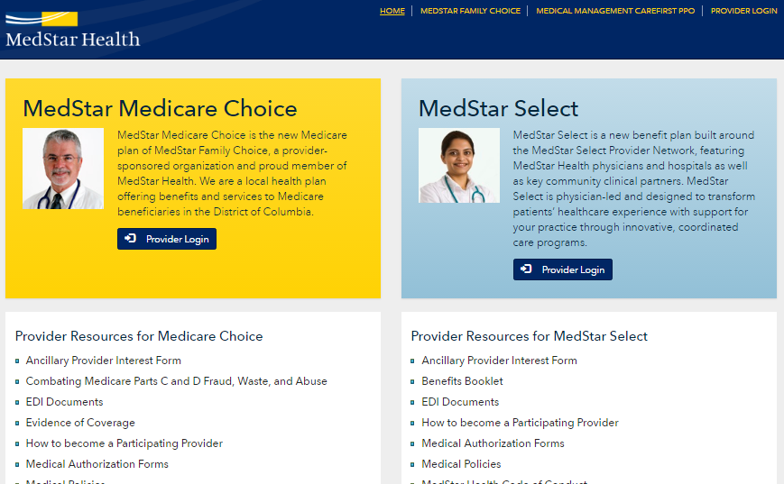
Provider Website

Slide 26
Provider Website Resources
Certificate of Coverage
Provider Manual
Medical Policies & Payment Policies
Utilization Management information including Prior Authorization requirements
Pharmacy information including protocols and the formulary (and a list of drugs covered under the medical benefit)
Behavioral Health Resources
Provider Directory
Provider Newsletters
Notice of Privacy Practices
Quick Reference Guide (including contact information)
Medical Management services and forms
Provider OnLine for access to claim information
Training Opportunities

Slide 27
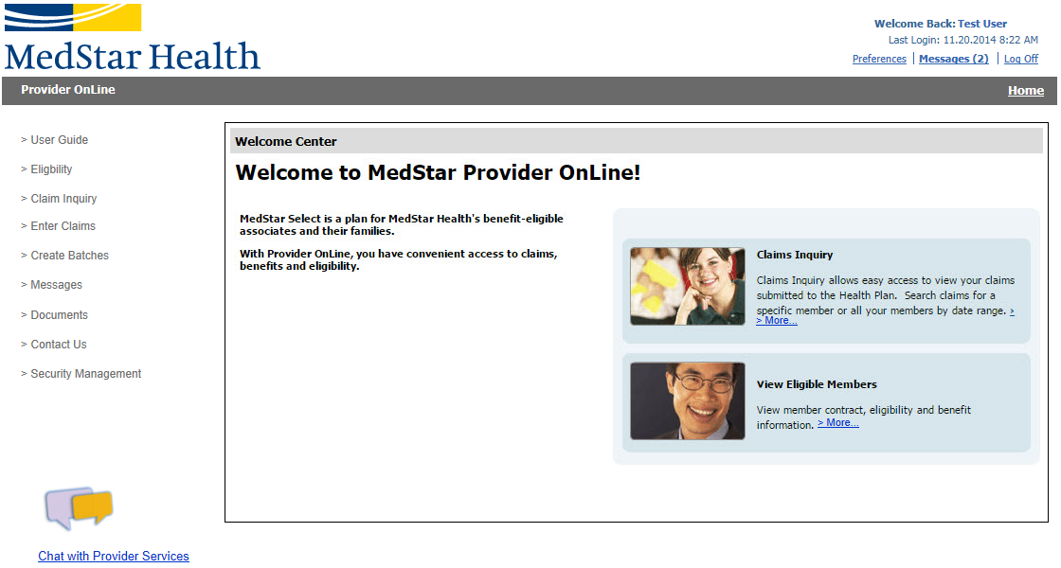
Provider OnLine Portal
Specifically designed for practitioners and providers affiliated with MedStar Select
The Portal allows quick and efficient access to claim, benefit, and eligibility information for our members.
In addition, providers can chat online with Provider Services by clicking the link at the bottom of the home page.

Slide 28
Provider OnLine Portal
1. Direct Provider Services Communicating
Save time by messaging or chatting online with Provider Services through the Provider OnLine Portal.
Communications are sent directly to the appropriate service area by selecting applicable topic.
Providers have the options to select topics such as, but not limited to, Eligibility, Authorization Inquiry, Claim Inquiry, or Batch Inquiry.
Register for the Provider OnLine Portal today! Sign up through https://secure.togetherforyourhealth.com/WebRequests/Requests/SecurityRequest.aspx?CLIENT=000101&ID=000001&DIV=0001
For further information on the Provider OnLine Portal, please contact Provider Services as 855.242.1042.

Slide 29
Provider OnLine Portal-Continued
Providers are able to:
2. Check Eligibility & Benefits
Member eligibility verification in ONE easy step.
Simply enter the Member ID, Last name, and First name, then click search.
Eligibility results for applicable dependents and subscribers display within seconds. The result details show the member's specific benefits and effective date of benefits.
3. Submit Claims
Offers a CST (Claims Submission Tool) that provides a complete Internet Portal solution for services provided by Health plan.
4. Check Claim Status
The Claim Inquiry search allows providers to search by member or claim information online to obtain real-time claim status.
Detailed HCFA and UB claim detail is supplied, including adjustment reasons by clicking on the applicable claim from the search results.
Providers who have questions on claims can compose an email to Provider Services on the claim detail screen directly.

Slide 30
Claims Submission
1. Direct Submission
Submit claims through Provider OnLine (provider portal) online on www.MedStarProviderNetwork.org
Register online or through Provider Services at 855.222.1042
2. Clearinghouse EDI Submission (recommended)
Providers with existing relationships with clearinghouses such as Emdeon, Relay Health, Allscripts may continue submitting claims in the format used by their billing software.
Clearinghouses will reformat to meet HIPAA standards
Electronic Submission: Payer ID 251MS
3. Paper Claims Submission
Paper claims can be submitted to:
Claims Processing Center
P.O. BOX 1200
Pittsburgh, PA 15230-1200
Key Reminders
Claims must be submitted within 180 days of date of service
COB claims – within 180 days of the primary EOP remittance
*Applies to all transmission Options

Slide 31
Electronic Prior Authorization Submission
The ability to submit prior authorization requests electronically is available.
You will have the option to access this functionality through Provider OnLine through Single Sign On, or you can choose to access Identifi Practice directly.
If you are interested in obtaining access to submission requests through Provider OnLine or through Identifi Practice, please notify MFC-ProviderRelations2@medstar.net to request permission and indicate if you are interested in accessing through Provider OnLine or directly into Identifi Practice.
If you are seeking access through Provider OnLine, you must be a registered user before the Electronic Authorization Submission functionality can be offered. If you are not currently registered with Provider OnLine, instructions are located at
MedStarProviderNetwork.org. A registered Administrator to Provider OnLine within your practice can grant access to additional users.
For technical issues related to Electronic Authorization submission, please contact support@evolenthealth.com.

Slide 32
Provider Appeals and Grievances
Written appeal to MedStar Select must be submitted by provider within 180 (medical necessity) or 120 (administrative) business days of the denial notification
The QRG is updated frequently and is a good source of information:
http://medstarprovidernetwork.org/medicare-choice/quick-reference-guide
http://medstarprovidernetwork.org/medstar-select/quick-reference-guide-frequently-updated
Call Medical Management at 855.242.4875 to request an expedited review for an appeal. Clinical documentation is required.
Use these forms to assist with Appeals, Grievances and Provider Issues found on MedStarProviderPortal.org:
Authorization Request Form
Administrative Reconsideration Request
Appeal and Grievance Request
Claim Appeal Request
Formal Appeal Request
Provider Claim Project Assistance Request

Slide 33
MedStar Health Verbal Consent
MD, VA, and DC Regulations
Verbal Consent to provide personal health information for an adult to another person is not permitted in MD, DC, or VA.
Therefore, for MedStar, all consent must be in writing before any PHI can be released for an adult member.
Members are required to fill out a release form which can be obtained from Member Services. It is in the process of being added to the www.MedStarMyHealth.org and to www.MedStarProviderNetwork.org.

Slide 34
MedStar Select Plan Vendor List
Benefit | Provider | Phone | Website
Medical | MedStar Select Plan | 855.242.4872 | MedStarMyHealth.org
 | CareFirst PPO Plan | 800.628.8549 | CareFirst.com
 | Kaiser Permanente | 800.777.7902 | KaiserPermanente.org
 | Kaiser HMO Plan | 301.468.6000 (local)
Prescription Drug | CVS Caremark | 888.771.7282 | Caremark.com
 | Kaiser Permanente | 800.777.7902 | KaiserPermanente.org
 |  | 301.468.6000 (local)
Dental | Delta Dental PPO Plus Premier Plan | 800-932-0783 | deltadentalins.com
 | DeltaCare USA Plan | 800-422-4234
Vision | Group Vision Services | 866.265.4626 | GVSmd.com
Flexible Spending Accounts | Trion | 800.580.6854 | EnrollOnline.com/MedStar
Employee Assistance Program | Business Health Services | 866.765.3277 | BHSonline.com Username: medstar
Wellness | MedStar MyHealth | 855.242.4871 | MedStarMyHealth.org

Slide 35
Fraud, Waste & Abuse
.

Slide 36
Fraud Waste and Abuse
Fraud is an intentional act of deception, misrepresentation, or concealment in order to gain something of value.
Waste is over-utilization of services and the misuse of resources.
Abuse is excessive or improper use of services or actions that are inconsistent with acceptable business or medical practice.
Sanctions can include revocation of license and suspension of payments.
Penalties can include fines and prison sentences.
You have a responsibility to report any possible cases of fraud, waste and abuse. Calls can be placed anonymously.
MedStar Health Integrity Hotline: Call 877.811.3411
If you identify or suspect fraudulent activities/behaviors, report immediately!

Slide 37
MedStar Health Compliance Program to Combat Fraud Waste and Abuse
Fraud is an intentional act of deception, misrepresentation, or concealment in order to gain something of value.
Waste is over-utilization of services and the misuse of resources.
Abuse is excessive or improper use of services or actions that are inconsistent with acceptable business or medical practice.
Sanctions can include revocation of license and suspension of payments.
Penalties can include fines and prison sentences.
You have a responsibility to report any possible cases of fraud, waste and abuse. Calls can be placed anonymously.
MedStar Health Integrity Hotline: Call 877.811.3411
If you identify or suspect fraudulent activities/behaviors, report immediately!

